Slide 1
Data Structures and Algorithms -3 (25CS2103E)
Symptom-to-Diagnosis Matcher
Team Members
S. RISHITHA REDDY - 2520090039
KIRAN SWAMY – 2520090035
SAHITHYA - 252009232
Under the Esteemed Guidance of
Dr. DYUTI BANERJEE
(AI&DS)

Slide 2
Contents
Abstract
Introduction
Literature survey
Problem Statement and Objectives
Hardware and Software requirements
Results
Conclusion
Future Scope

Slide 3
Abstract
Symptom-to-Diagnosis Matcher is a system that identifies possible diseases based on symptoms provided by the user.
Accepts multiple symptoms as input.
Matches user symptoms with disease-associated symptoms.
Uses data structures and algorithms for efficient symptom matching.
Calculates a matching score for possible diseases.
Displays the most relevant disease matches to the user.
Provides a simple and user-friendly approach to symptom-based disease identification.

Slide 4
Introduction
Identifying a disease based on multiple symptoms can be difficult and time-consuming.
Different diseases may have similar or overlapping symptoms.
Manual comparison of symptoms with different diseases requires considerable effort.
A computerized symptom-matching system can perform the comparison efficiently.
Our system accepts symptoms from the user and compares them with a structured disease–symptom dataset.
The system calculates matching scores and provides the most relevant possible diagnosis.

Slide 5
Literature Survey
Existing approaches for symptom-based disease identification include:
Manual Diagnosis: Requires comparison of symptoms with medical knowledge and can be time-consuming.
Rule-Based Systems: Use predefined rules to associate symptoms with diseases.
Search-Based Systems: Search large amounts of medical information but may provide excessive results.
Disease Prediction Systems: Use computational techniques to identify possible diseases.
Symptom Matching Approaches: Compare user symptoms with known disease-symptom patterns.
Research Gap:
There is a need for a simple and efficient system that can organize symptoms, compare them with disease records, and rank possible matches using data structures and algorithms.

Slide 6
Problem Statement and Objectives
Problem Statement
To develop a Symptom-to-Diagnosis Matcher that accepts symptoms provided by a user and identifies the disease that has the closest match with the given symptoms.
Objectives
Accept multiple symptoms from the user.
Store disease and symptom information efficiently.
Search for matching symptoms.
Compare user symptoms with disease symptoms.
Calculate a matching score.
Rank possible diseases based on the matching score.
Display the most relevant result in a simple interface.

Slide 7
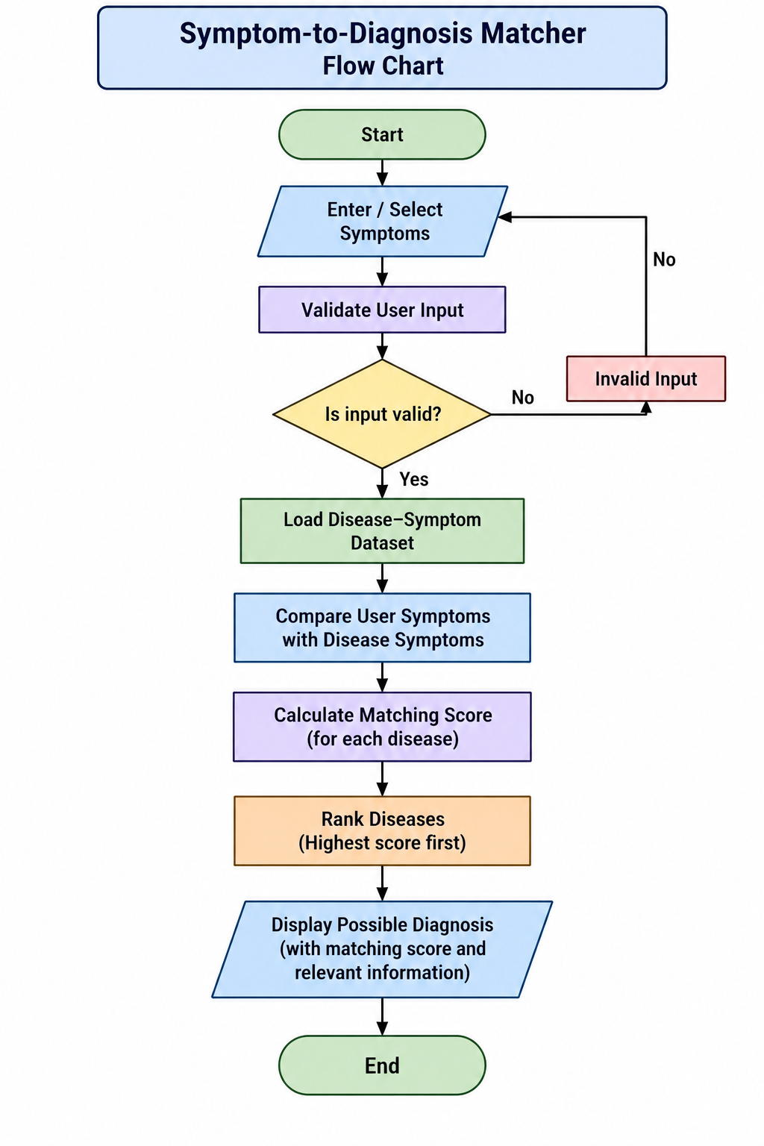
Flow Chart
Matching Formula:
Matching Score = (Number of Matched Symptoms / Total Disease Symptoms) × 100

Slide 8
Results
Sample Input
Symptoms:
Fever
Cough
Fatigue
Processing
The system compares the selected symptoms with the symptoms associated with each disease in the dataset.
Sample Output
Possible Diagnosis: [Predicted Disease]
Matched Symptoms:
Fever, Cough, Fatigue
Matching Score: XX%
Result: The disease with the highest matching score is displayed as the most relevant possible match.

Slide 9
Hardware and Software requirements
Hardware Requirements
Laptop / Desktop Computer
Minimum 4 GB RAM
Keyboard and Mouse
Internet Connection for development resources
Software Requirements
Operating System: Windows / Linux
Programming Language: [Your Language]
IDE: [Your IDE]
Dataset: Disease–Symptom Dataset
Version Control: Git / GitHub
Data Structures Used
Arrays / Lists
HashMap / Hash Table
Sets
Sorting structures

Slide 10
Conclusion
The Symptom-to-Diagnosis Matcher provides a structured method for matching symptoms with possible diseases.
The system can process multiple symptoms provided by the user.
Disease–symptom relationships are organized for efficient searching and comparison.
A matching score is calculated for each possible disease.
Diseases can be ranked according to their matching scores.
The project demonstrates the practical application of Data Structures and Algorithms to a real-world problem.
The system provides possible matches for informational purposes and should not be considered a medical diagnosis.

Slide 11
Future Scope
Expand the disease–symptom dataset.
Include symptom severity and duration.
Use weighted symptoms to improve matching.
Implement advanced similarity and ranking algorithms.
Add multilingual support.
Develop a mobile application.
Improve the user interface and accessibility.
Integrate verified medical information sources.
Add stronger testing, validation, privacy, and security features.

Slide 12
Thank you

